Slide 1
Minor Project Final Review
Project Title : Password Manager with Keystroke Identification System.
Batch – A3 :
19K41A0513 - K.Rishinandan
19K41A0517 - Mohammed Raamizuddin
19K41A0560 - V.Sai Likhitha
Project Guide
Dr. T Sampath Kumar

Slide 2
Project Domain :
Password Management with behavioural authentication.
Objective :
The objective of this Application is to Store and retrieve passwords for different accounts over the internet or various applications using an advanced authentication system which authenticates the user on his/her behaviour.

Slide 3
Existing System :
Users remember or manually maintain list for all the passwords for different accounts they hold.
Existing password managing applications have a complex interface with the traditional authentication system.
This authentication system can be compromised by an intruder.

Slide 4
Proposed System :
Our Password Manager Application has a graphical user interface developed using Java.
It stores the username and password details in the user created database.
The login to this password manager will be authenticated by a keystroke biometric verification system.

Slide 5
Methodology :
The user registers into the system using the Keystroke Biometric Identification technique.
The user then logs into the system by entering the username and password, these are authenticated for that user’s particular behaviour.
Once the user is logged in, he/she shall be able to manage the passwords that is stored by them into the database.

Slide 6
Modules :
User Registration Module: This module will have the fields to register the user. It has the username and password fields with the learning digraphs.
User Authentication Module: This module will have the fields to authenticate the user. It has the username and password fields with the authentication digraphs.
User Accounts-passwords Module: This module will have the details regarding the different accounts held by the user over the internet and various applications (i.e. their passwords and usernames).

Slide 7
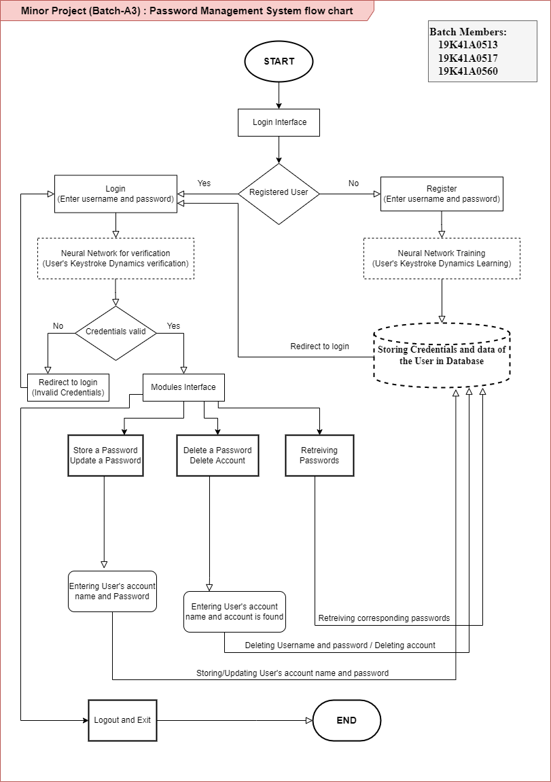
Flowchart of the
system :

Slide 8
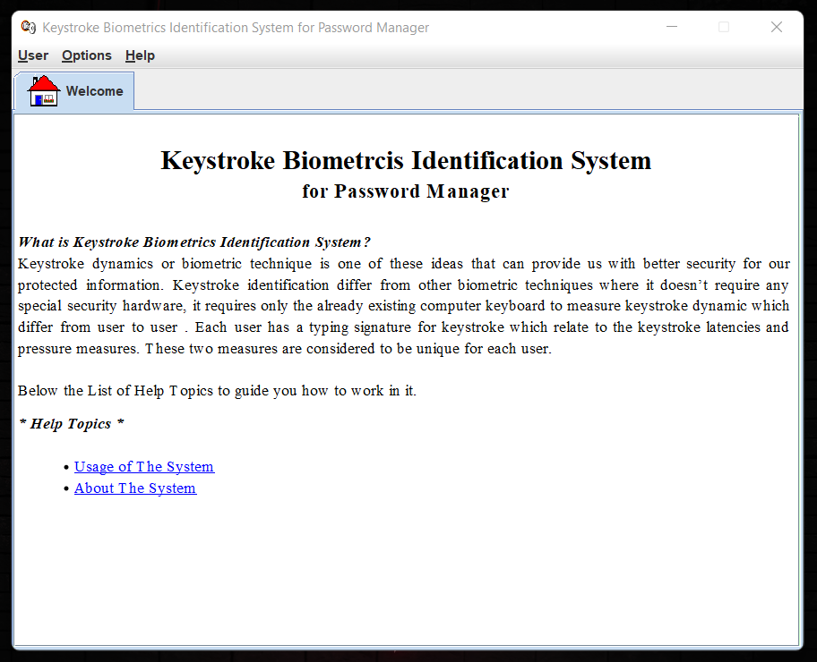
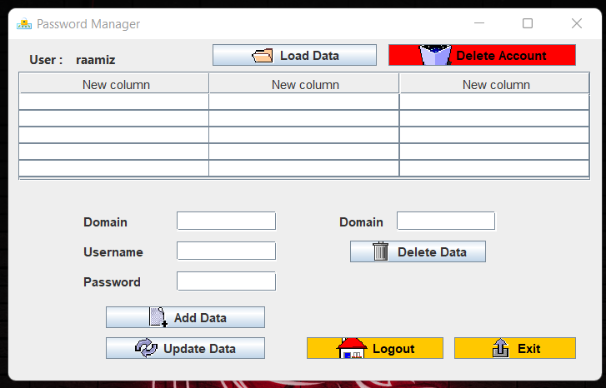
Application Demo:

Slide 9
Technologies used:
Java.
Digraphs for authentication.
MySQL Database.
Terminology :
Security.
Passwords.
Behavioral Authentication.

Slide 10
Thank you

